Slide 1

MINI PROJECT 2 TELECOM CUSTOMER CHURN(CLASSIFICATION)
BY
VIKASH KUMAR DIWAKAR
AI/ML INTERN, SCIFOR TECHNOLOGY

Slide 2
Why Analysing the Churn?
1.Churn Rate
The percentage of customers who discontinue their service during a given time period.
2. Customer Lifetime Value
The total revenue a company expects to earn from a customer over the entire duration of their relationship.
3. Customer Retention Rate
The percentage of customers retained over a specific period.

Slide 3
Introduction
In the highly competitive telecom industry, customer churn is a critical challenge that directly impacts profitability and growth. Churn refers to the percentage of customers who discontinue their service over a specific period, and managing it effectively is crucial for sustaining a healthy customer base. This project focuses on identifying key drivers of customer churn, leveraging advanced predictive modeling techniques to anticipate churn behavior, and implementing strategies to improve customer retention. By understanding the factors that contribute to churn, telecom companies can enhance customer satisfaction, reduce acquisition costs, and maximize lifetime value, ensuring long-term success in a dynamic market.

Slide 4
Problem Statement
Examine customer data from IBM Sample Data Sets with the aim of building and comparing several customer churn prediction models.

Slide 5




OVERVIEW OF ANALYSIS
Data Cleaning
Data Exploration
Predictive Modeling
Understand the structure of the dataset and clean data before analysis
Uncover initial patterns, characteristics, and points of interest using visual exploration
Formulate a statistical model to forecast an outcome using relevant predictors

Slide 6
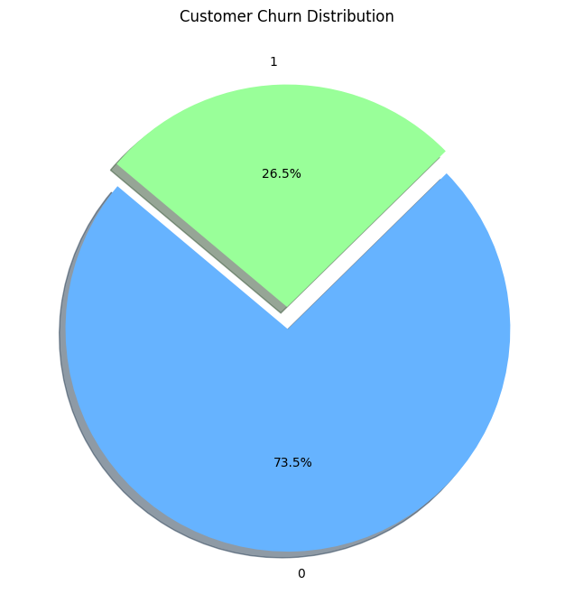
Churn Analysis
Almost 26% costmoers have churned or left the service.
The Dataset is heavily imbalanced will balance it in future steps.

Slide 7
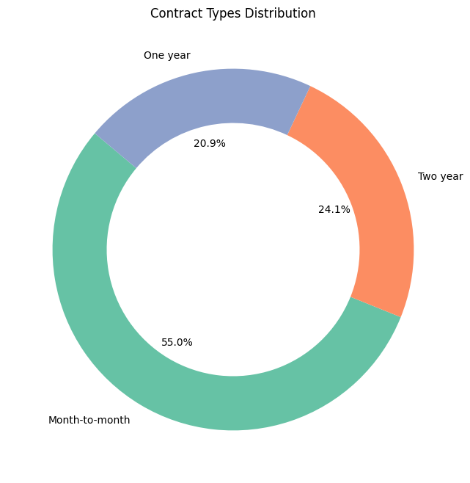
Contract Type
More than half of all customers chose month to month contract pay type.

Slide 8
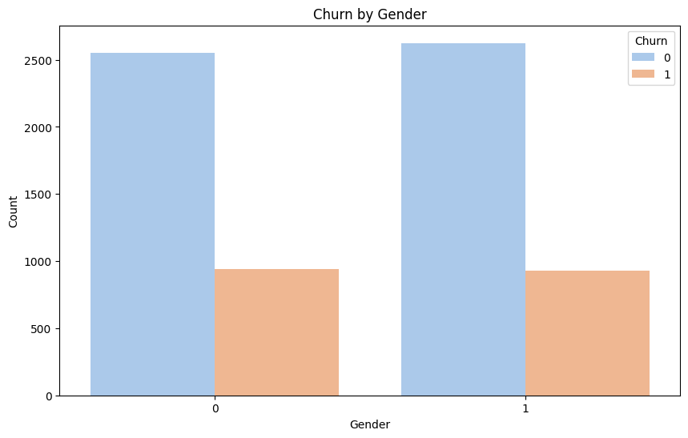
Churn by Gender
There is no relation of churn with gender almost equal contributions are there by both genders.

Slide 9
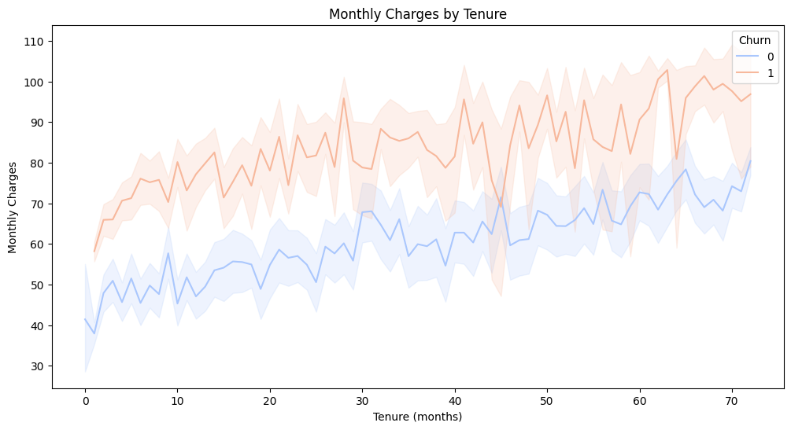
Monthly Charges
Customers with positive churn had a very high monthly income chargers compared with non churn customers

Slide 10
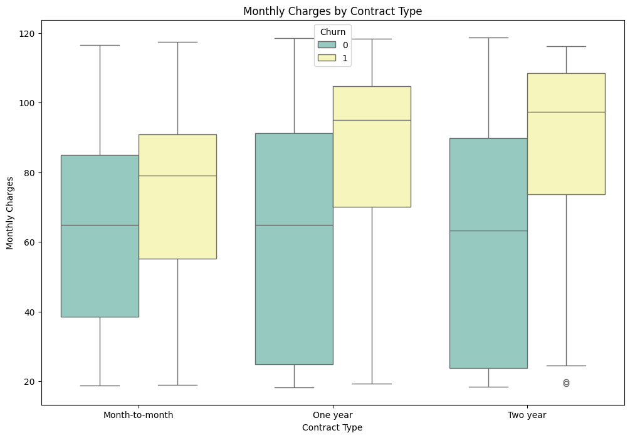
Monthly Charges vs Contract type
Average customers that churned had a one and two year contract type having monthly charges equally high.

Slide 11
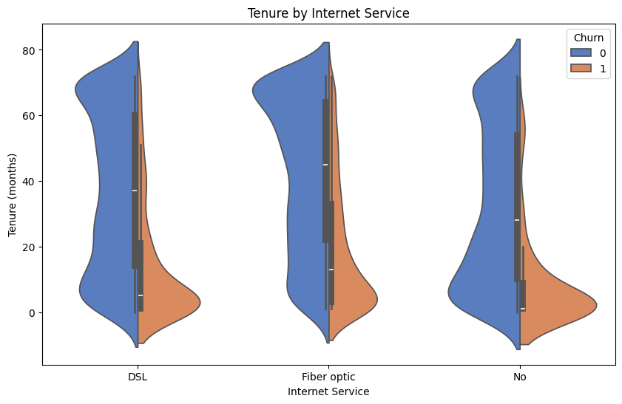
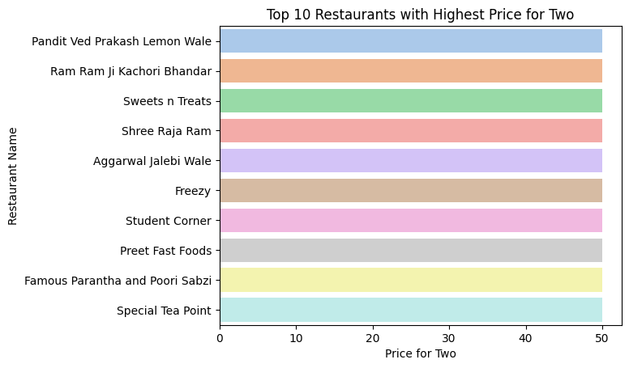
Tenure by Internet Users
Density of Customers with no internet services tends to have churned more often whereas fiber optic users churned very less.

Slide 12
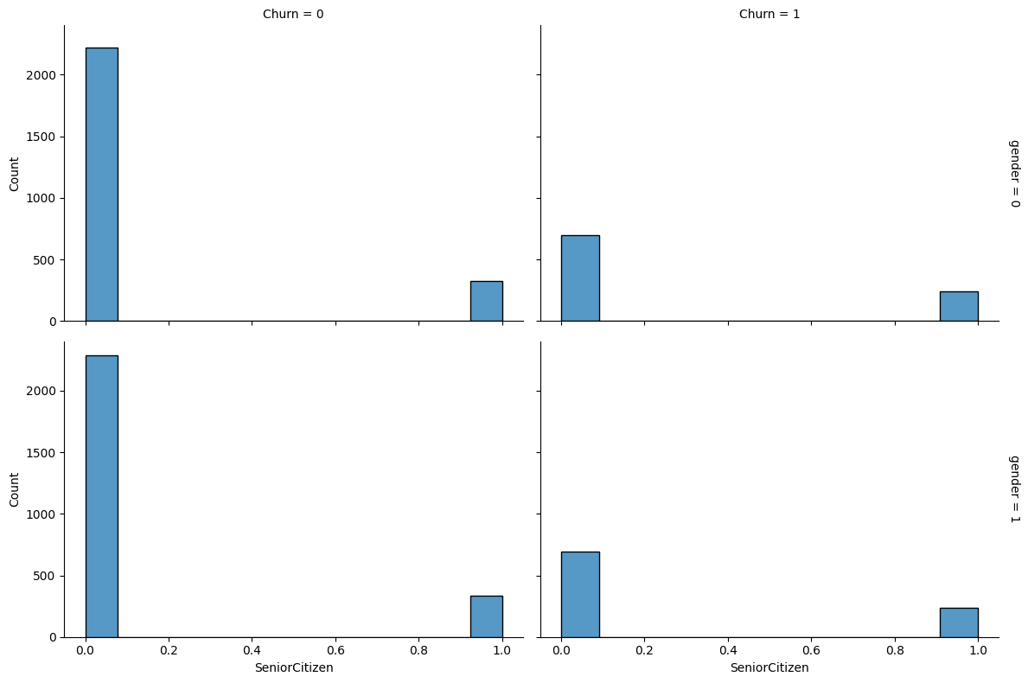
Senior citizens vs churn
Senior citizens tends to churn less.

Slide 13
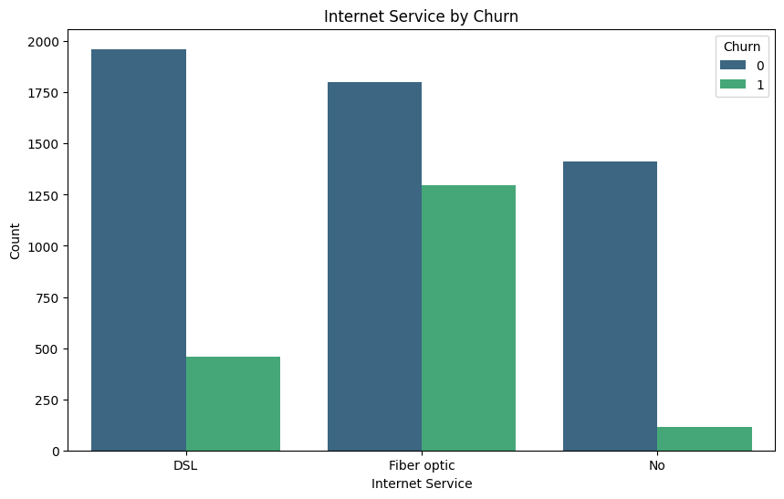
Internet service by Churn
The percentage of churn by the customers using fiber optic is very high as compared to others.

Slide 14
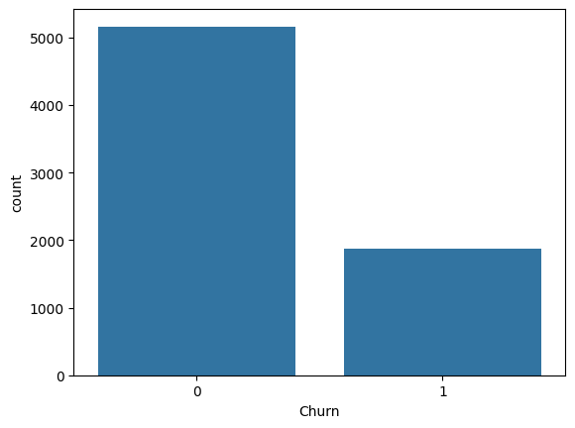
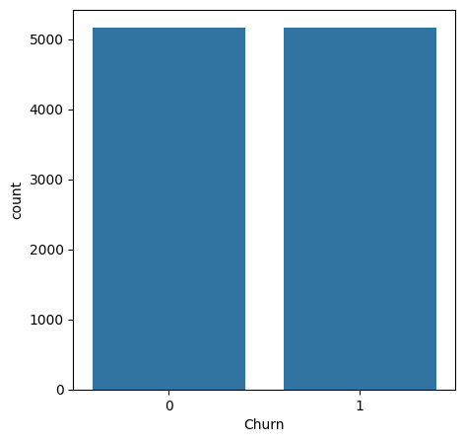
Handling Imbalanced Data using SMOTE
Upscaled the data suing SMOTE to handel class imbalance.

Slide 15
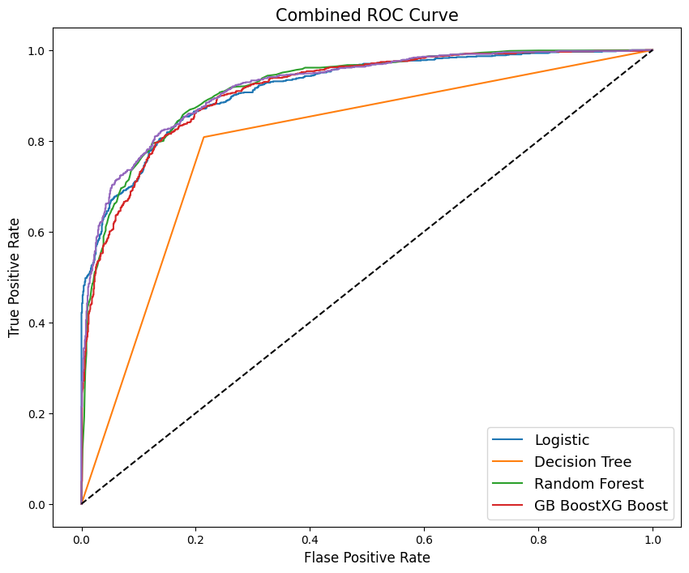
ROC Curve
Upscaled the data suing SMOTE to handel class imbalance.

Slide 16
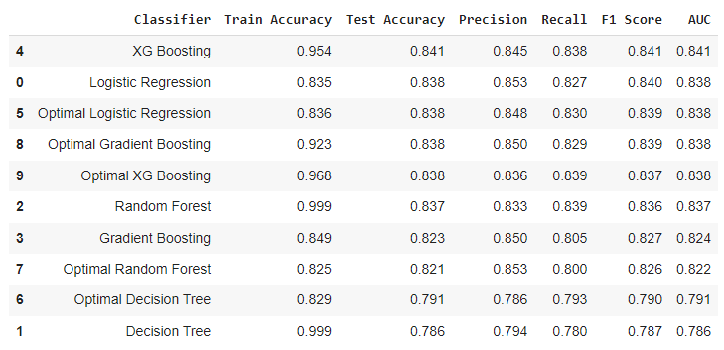
Overall Model Comparison
XG BOOST with no hyper-parameter tuning outperformed all other models.

Slide 17
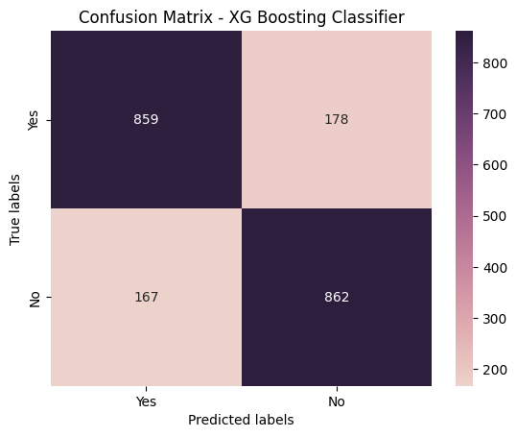
Confusion Matrix of XGB
Clearly see that our model is quiet good because it giving very less errors and predicting more true labels.

Slide 18
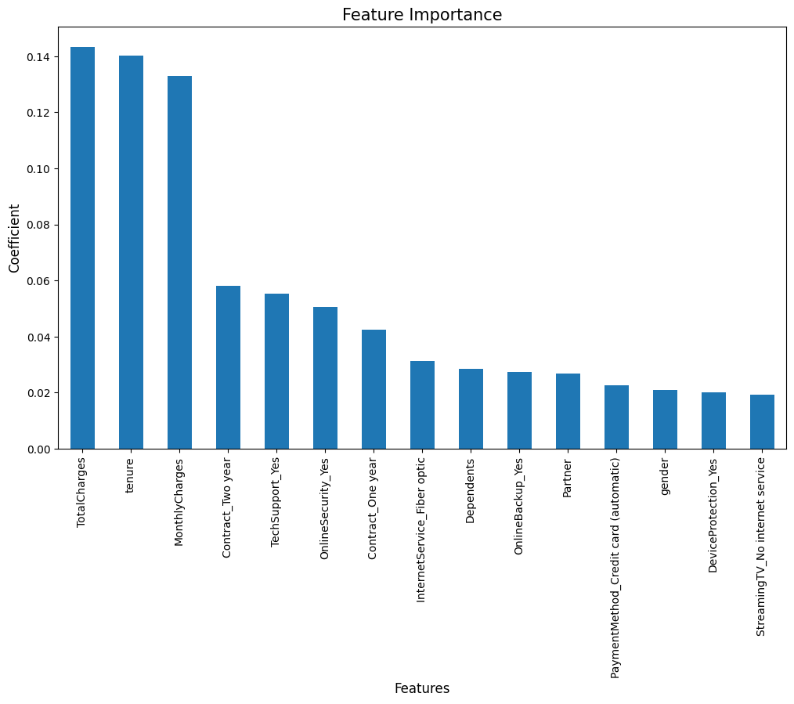
Feature Importance of XGB
Total charges is the most important feature followed by Tenure and monthly charges.

Slide 19
Challenges
Reading the dataset and comprehending the problem statement.
Examining the business KPIs for app development and devising a solution to the problem.
Handling the error, duplicate and null values in the dataset.
Designing multiple visualizations to summarize the information in the dataset and successfully communicate the results and trends to the reader.

Slide 20
Conclusion
To achieve this, we fit a random forest model on the training data, and the final predictions showed less errors compared to that of decision tree model.
To further improve the predictions of the model, we fit 2 boosting models namely; Gradient boosting machine (GBM) and Extreme gradient boost (XG Boost).
The predictions obtained from these models showed errors in the same range, but the errors were lower than that of decision tree model.
Plotted the ROC curve and it showed that RandomForestClassifier covers the highest area compared to other models.
implemented Hyper Parameter tuning to all the models.
Optimal Gradient Boosting gave a good recall overall.
since the criteria of selecting the best model i kept was AUC and Random Forest gave the highest AUC of 85.1%.

Slide 21

.
.

